Slide 1



SuccessFactors System Training
Presented by: HRIS SuccessFactors
X

Slide 2

TRAINING AGENDA
HRIS
Overview of the System
Accessing SuccessFactors/Helpful Resources
What do we use SuccessFactors for?
Organization Charts
Viewing and exporting org charts
Performance Objective Plan, Development Goal Plan, and Talent Review
Review the outlined talent processes from a system user experience
Reporting
How to run reports
HR Champion vs HRBP Access
Different HR user access in SuccessFactors

Slide 3
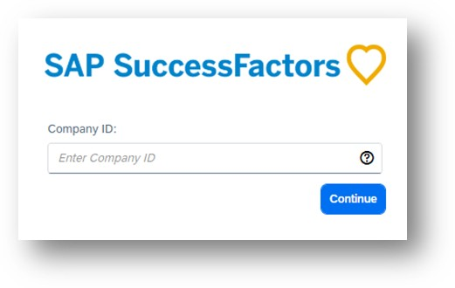
Accessing SuccessFactors/Helpful Resources
HRIS
SuccessFactors URL
All first-time users will be prompted to enter in the SuccessFactors Company ID
After it is entered once, users do not typically have to enter it in again
SuccessFactors Company ID: FL
Resources
Need Support?
Dashboard Navigation
Organizational Chart Navigation
People Profile Navigation
Reporting How-To (Specific to Year-End)
For any technical support or access assistance, please reach out to:
HRIS.SuccessFactors@footlocker.com

Slide 4
Overview of System
HRIS
What do we use SuccessFactors for?
Quick Facts about SuccessFactors
Objective Setting
Development Goals
Mentoring
Year-End Performance Management
Year-End Compensation Planning
Talent Reviews
Succession Planning
PeopleSoft is the system of record; most data entered in SuccessFactors does not flow back to PeopleSoft, except for select updates such as year-end performance ratings
Teammate data is sent from PeopleSoft to SuccessFactors through a daily integration feed, with changes appearing on or after their effective date
SuccessFactors currently supports Global Non-Store and WSS Non-Store teammates, with North American Store Managers and Assistant Managers being added soon
Performance Management forms are available back to 2016

Slide 5
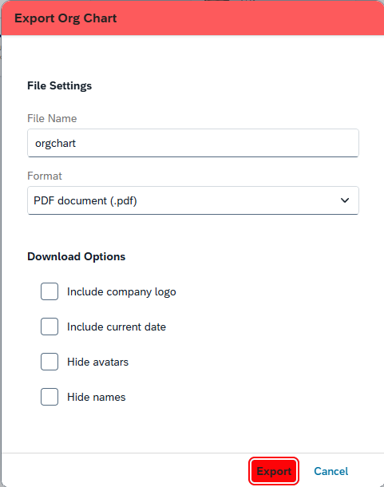
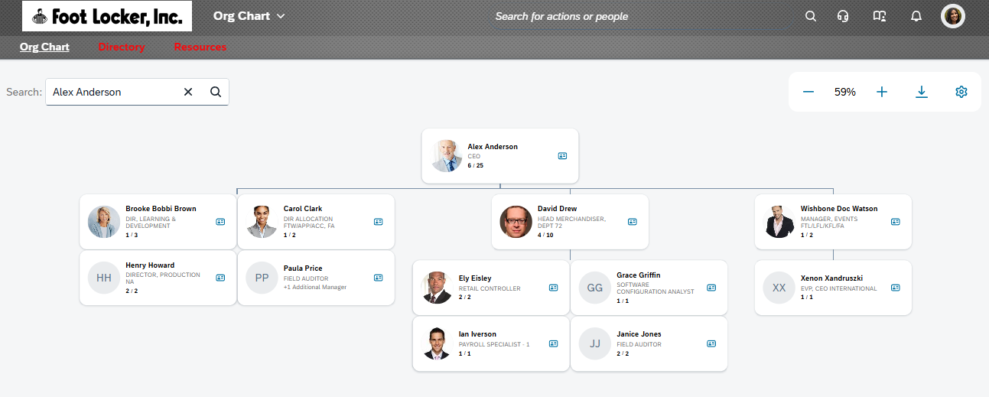
Organization Chart
HRIS
Viewing and Exporting Org Charts

Slide 6
Performance Objective Plan, Development Goal Plan, and Talent Review
HRIS
Review the outlined talent processes from a system user experience
Objective Plan
Development Plan
Talent Review
Create/Cascade Objectives
Flexible objective plans that only close during the YE Cycle
Track status of objectives
2026 Objective Form
1 form for all users
Max of 6 objectives
No objective weightings
1 overall objective category
Create Development Goals
Flexible development plans, however, development plans incorporate fiscal year dates
Track status of development goals
***No 2026 Development Plan
Teammates are advised to use 2025 Development Plan
Targeted Talent Review process for North American Director+ population; but open to all teammates globally
Teammate – completes Talent Footprint categories
Leader – completes Talent Readiness and Succession Planning
HR Champion – Generates Talent Card based on data inputs from Teammate and Leader

Slide 7

Reporting
HRIS
How to Run Reports
LIVE SYSTEM DEMO

Slide 8
HR CHAMPION VS HRBP ACCESS
HRIS
Different HR user access in SuccessFactors
What is HR Champion Access?
HR Champion access allows you to be the HR representative in SuccessFactors to access a specific population.
HR Champions have access to the following for the populations they support:
Performance Reviews
Development Goals
Comp Planning
Objective Setting
Talent Review Updates
While we have global HR Access for HRBPs in SuccessFactors, this access is mainly for reporting.
EX: A non-HR Champion HRBP will not be able to view a teammate’s PM form, but they would be able to run a report to view the PM form information.
HR Champion Access Request
Email HRIS.SetupRequests@footlocker.com with the Head of Departments and/or the functional team that you need HR Champion access to
Requests will be processed in PeopleSoft first and then feed over to SuccessFactors (typically by the next day)

